Slide 1
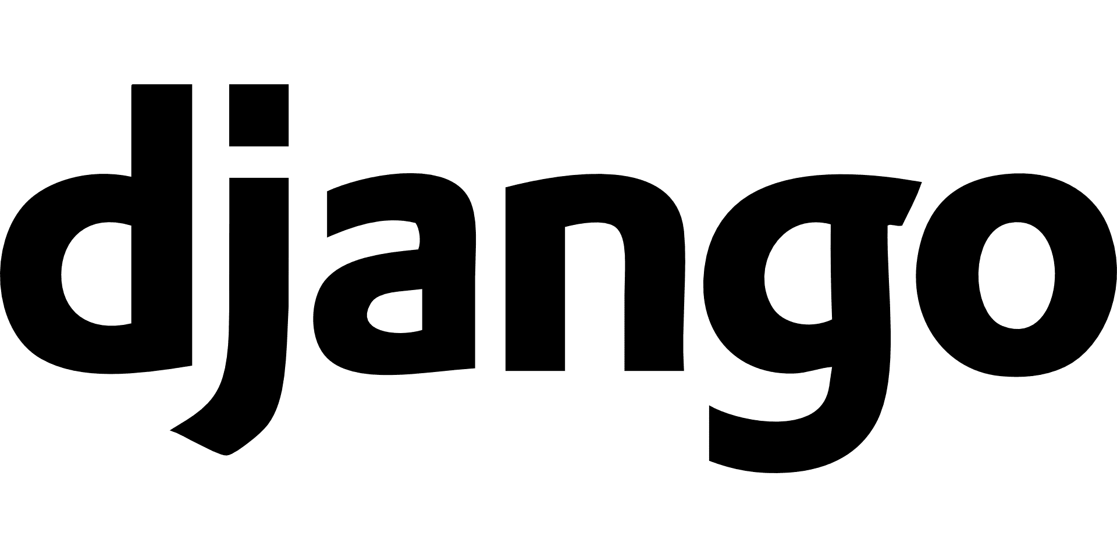
Framework Presentation
Notes:
Welcome to the Framework Presentation, where Django has been selected as web developing framework.

Slide 2
“The Django website is very well organized and it is easy to navigate and get answers.”
Source: (Plekhanova, 2009)
Notes:
Plekhanova in the year 2009 in their research paper stated on Django that “The Django website is very well organized and it is easy to navigate and get answers.”

Slide 3
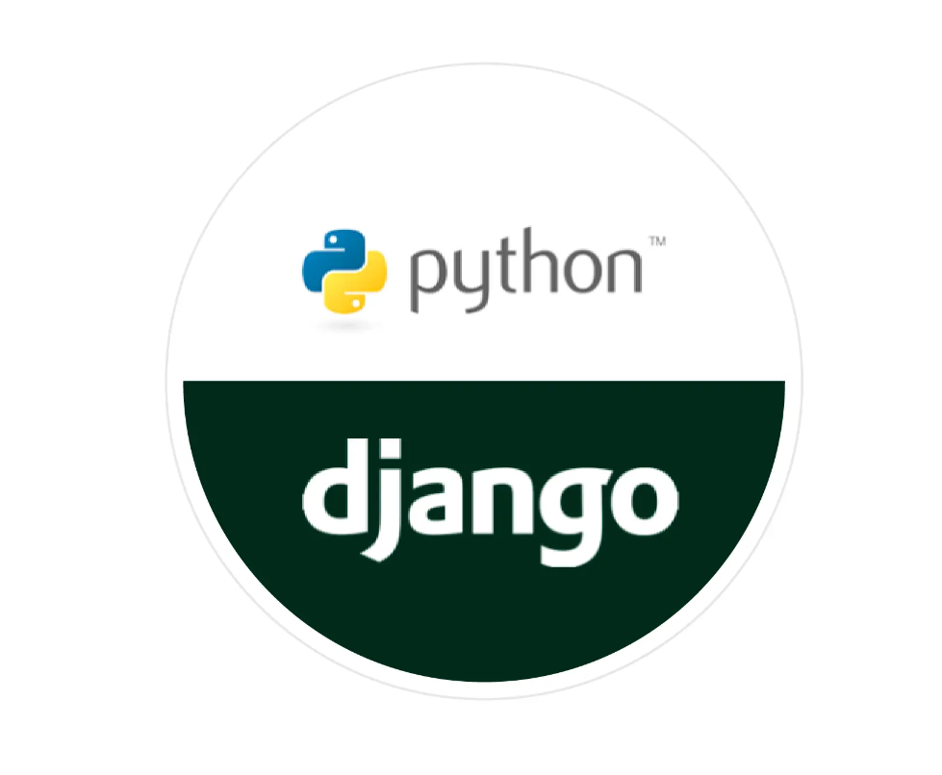
Introduction to Django
Django is a high-level Python web framework that allows the rapid development of safe and maintainable websites.
Django was first introduced in 2003 by Simon Willison and Adrian Holovaty.
Later it was released in 2005 and it is free and open source (Ghimire, 2020).
In recent times, Django has a few tens of thousands of users and development figures.
Notes:
The Django is known as a high-level Python-based wave development framework which enables rapid development for websites. This web development framework was first introduced in the year 2003 and later released in the year 2005 as an open-source platform. In the current situation, this framework contains thousands of users using their framework.

Slide 4
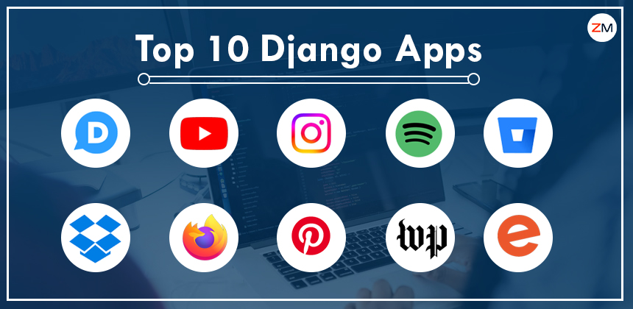
Django Users
Large technology companies such as Mozilla, Udemy, Netflix, Spotify, Instagram, Uber, Pinterest as well as YouTube, employ Django.
Django has a successful and engaged community.
It has generous documentation, and considerable options for free and paid-for support.
Notes:
It has been accumulated that top multinational companies like Mozilla, Udemy, Netflix, Spotify, Instagram, Uber, Pinterest and YouTube use the Django framework in their applications. This framework allows free as well as paid options which is why it has a successful and engaged community.

Slide 5
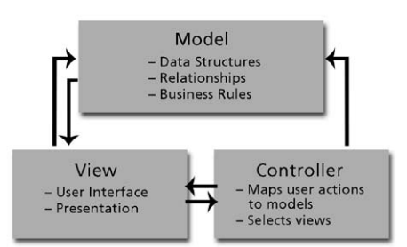
Technical Aspects
Django follows the Model-View-Template (MVT) architecture (Vamsi et al., 2021).
The Model in Django is liable for handling databases.
In Django, the View executes business logic, interacts with the Model for data, and handles what is depicted by rendering the Template, which endures the User Interface.
Fig: illustrates MVC and the interaction between the components
Source: (Plekhanova, 2009)
Notes:
In terms of the architecture of Django, it follows MTV or model view template architecture. Django is responsible in order to handle databases. It's where the users will define their data structure, fields, and their behaviour.

Slide 6
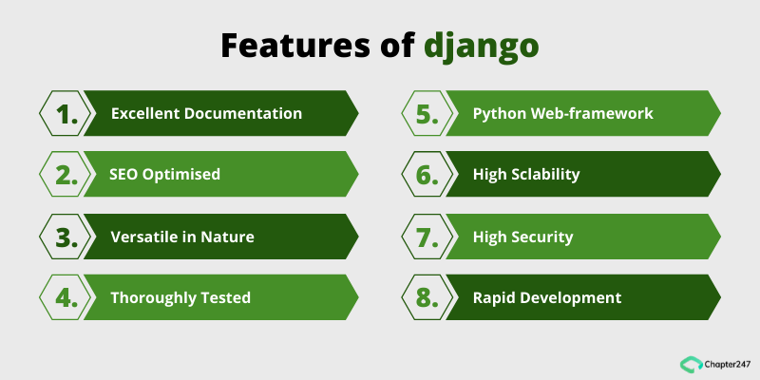
Django’s Features
Django is comprehended for its “batteries-included” philosophy, delivering almost everything developers might desire to do “out of the box”.
It incorporates features like a strong user authentication system, content administration, site maps, RSS feeds, and many more tasks right out of the box.
Django helps middleware classes that authorise global customization of input or output.
Django provides HTTP libraries to handle requests and responses (Team, 2022)).
Notes:
Django is indeed known for its “batteries-included” philosophy, providing almost everything developers might want to do “out of the box”. It includes features like a robust user authentication system, content administration, site maps, RSS feeds, and many more tasks right out of the box. In addition to these features, Django also supports middleware classes that allow for global customization of input or output. This means you can add functionality to Django’s request/response process by hooking in your functions at certain points. Furthermore, Django provides HTTP libraries to handle requests and responses. This makes it easier to build web applications that can interact with other websites and services.

Slide 7
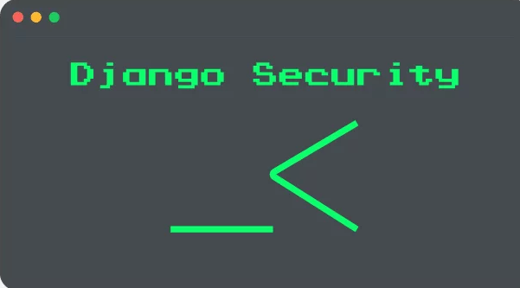
Security in Django
Django provides a secure way to manage user accounts and passwords.
Django’s template system guards against the prevalence of XSS attacks by escaping specific characters that are “dangerous” in HTML (Django, 2023).
Django uses built-in SQL injection protection, enabling users to secure their data and user information.
Django provides built-in protection against most types of CSRF attacks, delivering users who have enabled and operated it where applicable.
Notes:
DJ ago provides a secure way in order to manage user accounts as well as passwords. It protects against XSS attacks by escaping certain characters in HTML. It also has built-in SQL injection protection to secure data and user information. Moreover, the Jungle offers protection against most types of CSRF attacks ensuring requests are accepted only from authenticated sources.

Slide 8
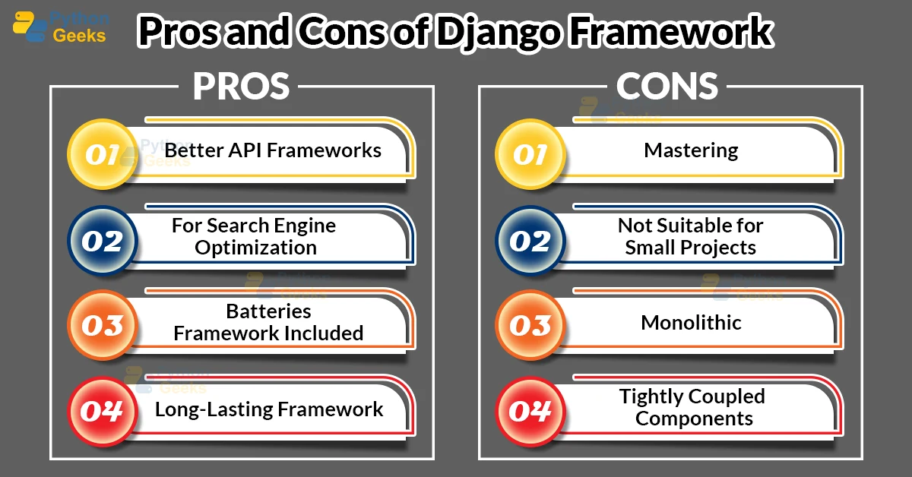
Advantages of Django
Django has a better API Framework, CDN Connectivity and it is SEO-friendly.
Django includes its portability, speed, security, and “batteries-included” framework.
It is open-source nature with a massive community and superior Content Delivery Network Connectivity (Team, 2022).
Notes:
Django REST Framework in Django has a customizable and modular architecture that can be used for simple and sophisticated APIs. Most of the Python Source Code is human-readable, which makes it an SEO-Friendly Framework. Django is best known for its Content Delivery Network Connectivity.

Slide 9
Disadvantages of Django
Django may not be suitable for small projects as it demands considerable server processing time and bandwidth to design large applications quickly.
As it has its own architecture, it is Monolithic (Team, 2022).
It even lacks support for multiprocessing and some features in the Object Relational Mapper (ORM) system.
It cannot handle multiple requests at one time.
Notes:
Django, being a modern web framework, does not support handling multiple requests simultaneously. Therefore developers have to come up with different approaches to deal with multiple requests rapidly. Django does not provide a lot of freedom when it comes to project architecture, Django has its way of doing things. If a developer tries to implement something out of the file structure then there is no way Django can access the file. Django is particular when it comes to performing tasks in a certain way.

Slide 10
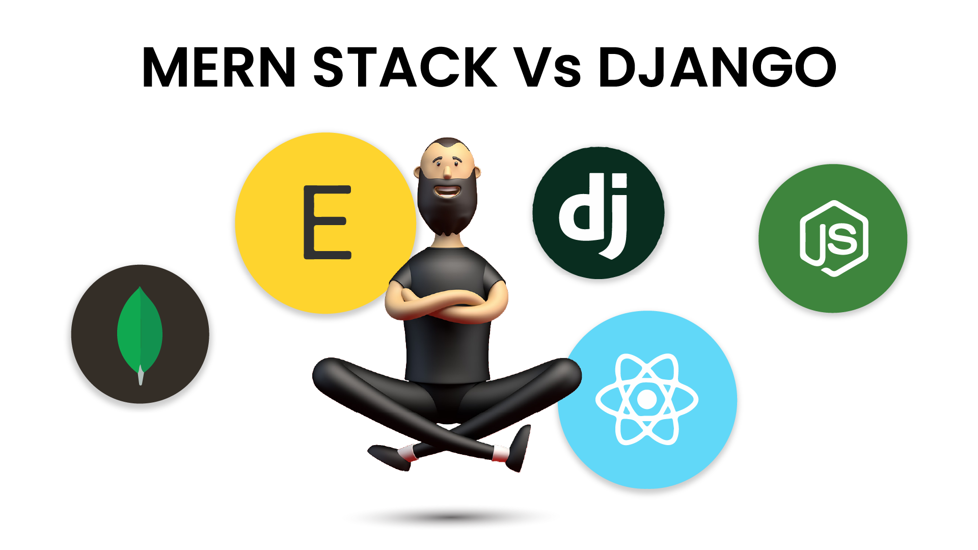
Comparison with MEAN/MERN
Django stands out for its entire suite of features like data binding along boilerplate coding.
In comparison to MEAN/MERN, Django is better suitable for the fast development of applications.
Django proposes flexibility, reusability, and high productivity.
For productivity, MEAN/MERN is appropriate for building large-scale apps.
Notes:
The Jungle is known for its comprehensive sweet of features including data winding and boilerplate coding which makes it suitable for rapid collection development. Compared to the MEAN/MERN stack Django might be a better choice for certain applications due to these features. However, for building large-scale applications, the MEAN/MERN stack could be more appropriate due to its scalability and full-stack JavaScript development capabilities.

Slide 11
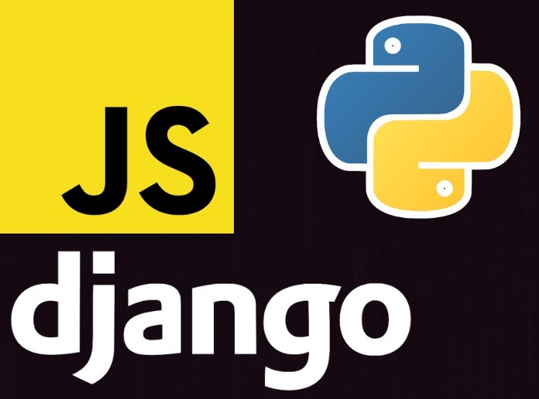
Comparison with JavaScript Frameworks
For small websites or single-page applications (SPA), a JavaScript-based framework like React or Angular might be a better choice.
The ecosystem around JavaScript frameworks is additionally fragmented which is why to the number of competing libraries and tools.
Notes:
For small websites that are single-piece applications JavaScript best frameworks like react or angular could be more suitable due to their lightweight nature and client-side rendering capabilities. These frameworks allowed for a more interactive user experience which is often required in SPAs. However, the ecosystem around JavaScript frameworks is more fragmented due to the number of competing libraries and tools. This means that while there are many options available it can also take more work to decide on the right tools to use for the project.

Slide 12
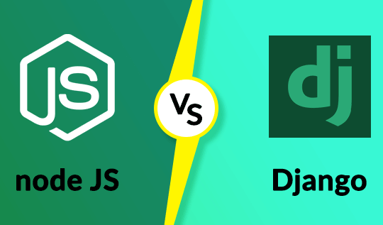
Comparison with Node.js
For real-time, highly concurrent applications like Node.js might be a more acceptable choice as it is built on an event-driven, non-blocking I/O model.
Node.js is highly scalable meeting the requirements of a real-time app.
Customization is better with the help of Node.js.
For real-time, highly concurrent applications, Node.js might be a better choice since it is built on an event-driven, non-blocking I/O model.
Notes:
For real-time highly concurrent applications, node.js could be a more suitable choice. It's built on and event-driven, non-blocking, I/O model which allows it to handle a large number of concurrent connections with minimal overhead full stop this makes it highly scalable and well-suited for real-time applications that are required to maintain persistent connections to the server. Additionally, node.js allows for greater customization and gives developers more control over the application's behaviour as well as performance. However, it's important to note that the choice between node.js and other frameworks like Django would depend on the specification of the project.

Slide 13
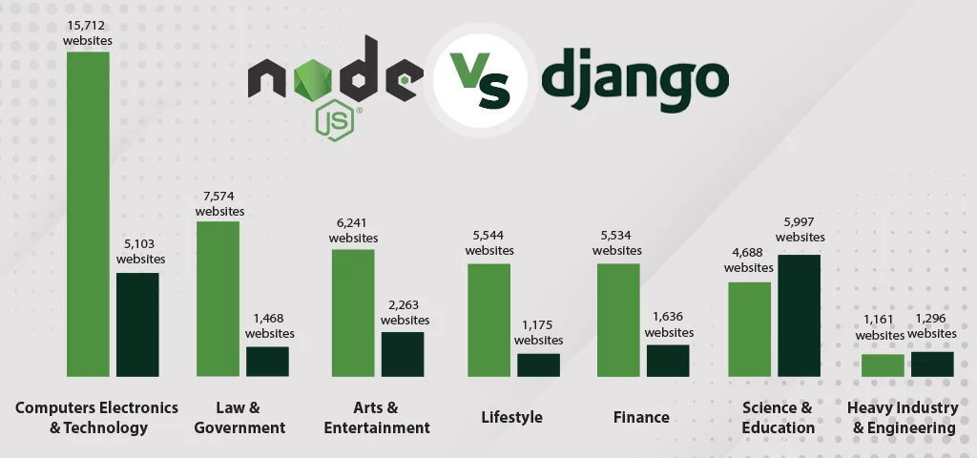
Django & Node.js Framework
Notes:
The image is an infographic comparing the number of websites built with Node.js and Django across different industries. The industries include Computers Electronics & Technology, Law & Government, Arts and entertainment, Lifestyle, Finance, Science & Education, and Heavy Industry & Engineering. The infographic shows that Node.js is used in more websites across all these industries compared to Django. However, both frameworks are popular and widely used in the web development community. The choice between Node.js and Django often depends on the specific needs and constraints of the project.

Slide 14
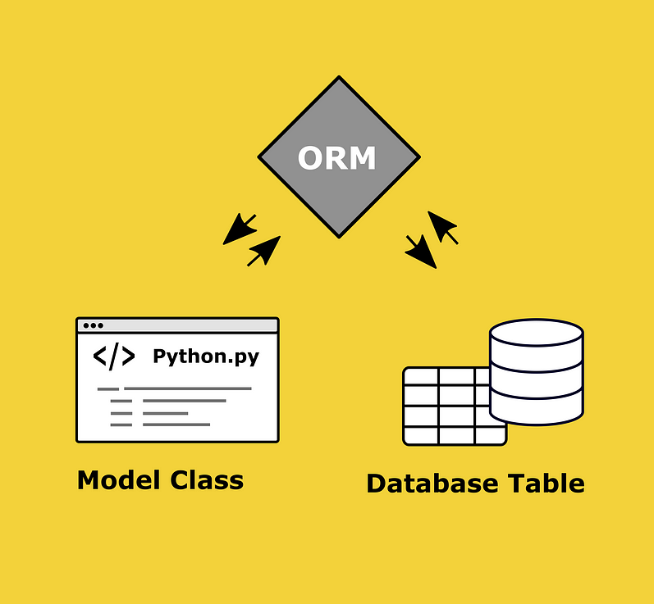
Suitability of Django
Django is an excellent choice for developing robust, scalable web applications with a lot of data.
Its built-in ORM (Object-Relational Mapping) makes it easy to work with large amounts of data.
It is a complex data-driven application as it has built-in security frameworks.
Django is appropriate for large-scale projects due to its “batteries-included” philosophy.
Notes:
Django is an excellent choice for developing strong scalable wave applications particularly when dealing with large amounts of data. Its built-in object-relational mapping or ORM simplifies interactions with the database making it easier to work with ladder data sets. Django's built-in security features also make it a good choice for complex data-driven applications that require robust security measures. Django's batteries included philosophy comes with many features and tools out of the box making it suitable for large-scale projects where a comprehensive set of functionalities is required.

Slide 15
Conclusions
Django is a versatile framework that can be utilised for a wide range of projects, from simple websites to complicated web applications.
Django has an extensive and active community, which suggests it’s easy to find support and resources.
Nevertheless, it may not be the best choice for every project.
For smaller projects or real-time applications, other frameworks might be more suitable.
Notes:
Django is a versatile framework that can be used for a wide range of projects from simple websites to complex wave applications. Its comprehensive set of features and tools make it a powerful choice for developers. furthermore, Django has a large and active community which makes it easy to find health as well as resources in a time of need. However, the Jungle might not be the best choice for every project. For smaller projects on real time applications other frameworks like Flask for Python, or Node.js and Express.js for JavaScript, might be more suitable. These frameworks are lighter and can be more efficient for smaller-scale or real-time applications.
In conclusion, the choice of framework largely depends on the specific requirements of the project. It’s important to consider factors like the size and complexity of the project, the need for real-time features, and the language proficiency of the development team.

Slide 16
References
Ghimire, D. (2020). Comparative study on Python web frameworks: Flask and Django.
Vamsi, K. M., Lokesh, P., Reddy, K. N., & Swetha, P. (2021). Visualization of real world enterprise data using python Django framework. In IOP Conference Series: Materials Science and Engineering (Vol. 1042, No. 1, p. 012019). IOP Publishing.
Plekhanova, J. (2009). Evaluating web development frameworks: Django, Ruby on Rails and CakePHP. Institute for Business and Information Technology, 20, 2009.
Django. Django Project. (2023). https://docs.djangoproject.com/en/4.2/topics/security/
Team, P. (2022, January 6). Features of python django framework. Python Geeks. https://pythongeeks.org/features-of-python-django-framework/

Slide 17
Thank You!

